Slide 1
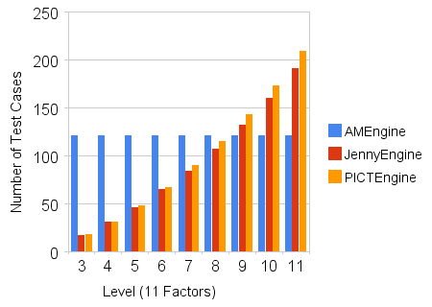
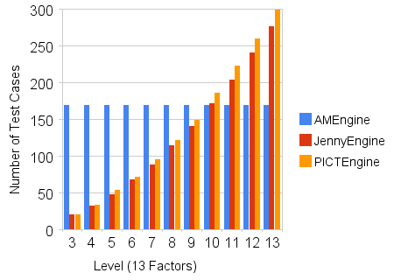
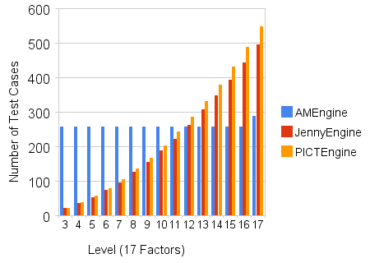
Enhanced OAProviderFactorys
IOAProviderFactory
  OAProviderFactory
  SelfRuleOAProviderFactory

Slide 2
Enhanced MetaParameterProviders
Java Excel API
  http://www.andykhan.com/jexcelapi/tutorial.html
Apache Jakata POI
  Java API To Access Microsoft Format Files
  tm-extractors
    String WordExtractor.extractText(InputStream in);
JACOB
  A Java-COM Bridge
Python win32com
  http://sourceforge.net/projects/pywin32/

Slide 3
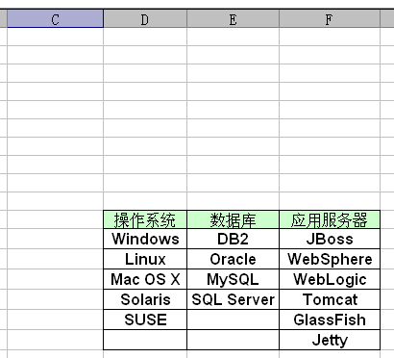
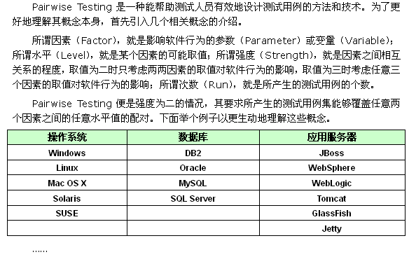
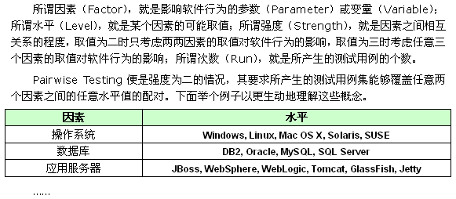
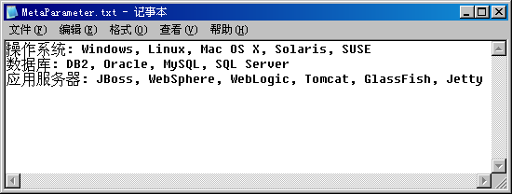
Enhanced MetaParameterProviders
IMetaParameterProvider
  XMLMetaParameterProvider
  FileMetaParameterProvider
    ExcelMetaParameterProvider
    WordMetaParameterProvider
    TextMetaParameterProvider

Slide 4
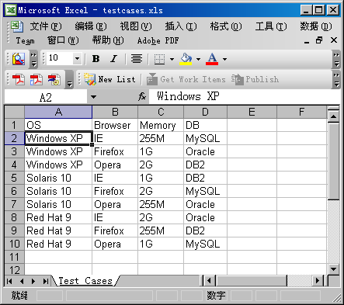
Enhanced TestCasesGenerators
ITestCasesGenerator
  TXTTestCasesGenerator
  XMLTestCasesGenerator
  ExcelTestCasesGenerator

Slide 5
Next
IMethodUnderTestXMLHelper
    String toXML(MethodUnderTest m);
    MethodUnderTest fromXML(String xml);
    /**
    * @param m the given MethodUnderTest
    * @param values the values assigned to simple type
    * @return the instances of the MethodUnderTest's parameters
    */
    Object[] assign(MethodUnderTest m, String[] values);
TestNG Test Case Template Update
Integrate with Eclipse Plugin Client

